Slide 1
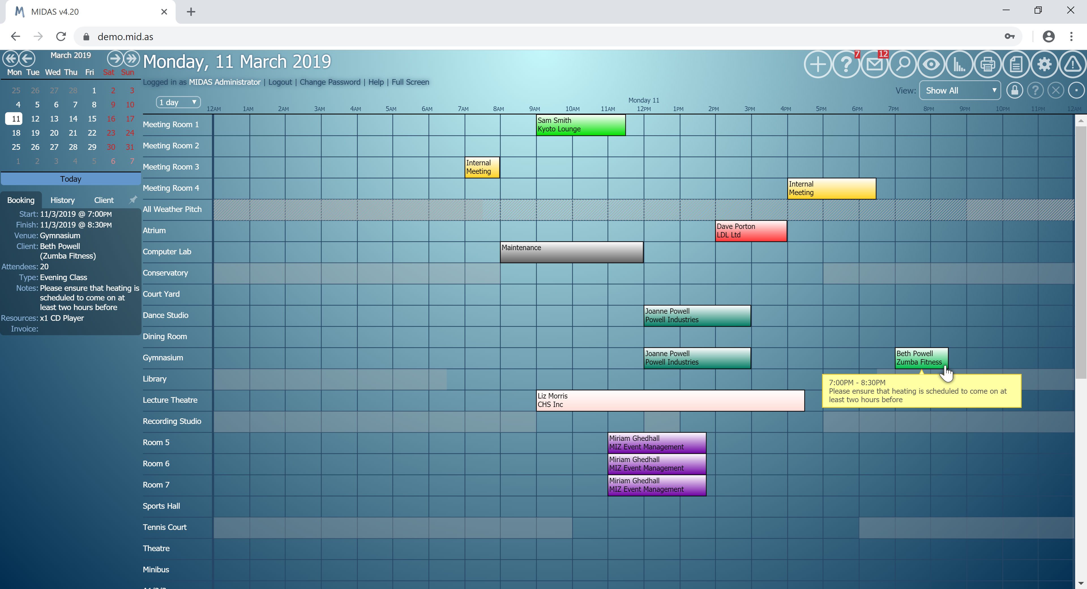
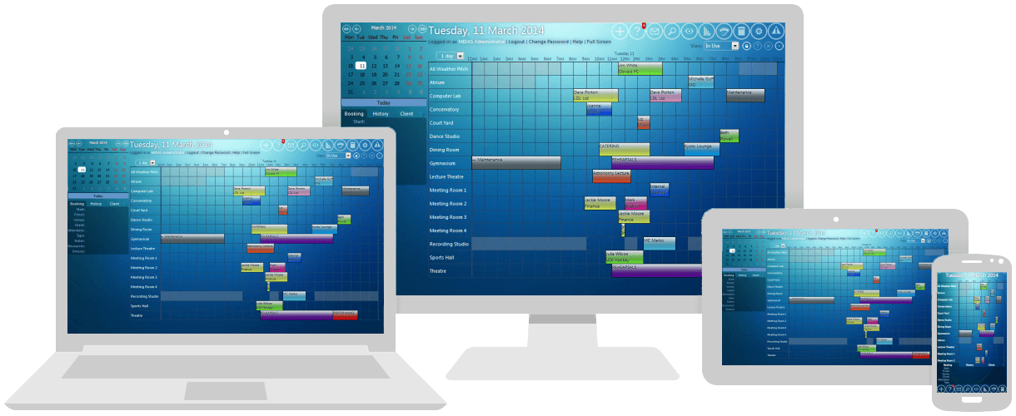
https://mid.as
MIDAS is a complete web based scheduling solution for managing your facility’s bookings and resources.
MIDAS can be accessed using a modern web browser on your desktop, laptop, tablet or mobile device. All major browsers are supported!
MIDAS is available in multiple languages, including English, French, German, Italian, Spanish, Norwegian, Dutch, and Greek
…Making your facilities work for you!

Slide 2
AVAILABLE IN TWO EDITIONS
https://mid.as
MIDAS is available in two options to suit every requirement:
Cloud Hosted System
Self Hosted System
Have your MIDAS system hosted in the cloud, and accessible via your own *.mid.as subdomain
Download, install, and run MIDAS from your own web server *
* For Server Requirements see: https://mid.as/sysreq

Slide 3
KEY MIDAS FEATURES - Bookings
https://mid.as
MIDAS won’t allow you to double-book venues – ever!
Book by start/end time, start time/duration, number of nights, or pre-defined time slot
Add new bookings by simply clicking and dragging across the booking grid
With just a few clicks you can quickly add recurring bookings
Bookings can be “color coded”, so different types of bookings will be easier to see
View bookings in a single-day or multi-day grid, or as a monthly overview

Slide 4
KEY MIDAS FEATURES - Bookings
https://mid.as
Equipment, Staffing, and Consumables can be assigned to your bookings, and MIDAS won’t allow you to add more than you have!
Send email booking confirmations and automated reminders to clients
Quickly reschedule bookings by simply “dragging” them to a different time or venue
Allow visual booking from floor plans and maps
Printouts can be made of an entire day’s bookings, or just for certain venues, between certain times, or over a range of dates
Attach reminders or informational notes to specific calendar dates for all users to see

Slide 5
KEY MIDAS FEATURES - Bookings
https://mid.as
Make “confirmed” or “tentative” bookings (“tentative” bookings auto-expire if not subsequently confirmed)
Add your own custom text, number, list or URL booking fields
Upload and attach documents to bookings (Available in “self hosted” editions only)
MIDAS can suggest alternates in the event desired venues/times are unavailable
MIDAS can send cancellation notifications to clients when their bookings are removed
Import bookings from Google Calendars, Yahoo Calendars, MRBS, and other applications

Slide 6
KEY MIDAS FEATURES - Venues
https://mid.as
Operating hours for each venue can be defined, and users prevented from booking outside these
Hourly, Daily, or Fixed hire rates can be set for each venue on each day of the week, and you can have variable rates based upon the length, time of day length or type of booking
Maximum occupancy levels can be set and enforced for each venue
Venues can be “grouped” and access to groups can be controlled on a per-user basis
Venue “blocking” rules can be set to prevent bookings taking place in certain venues when certain other venues are in use
You can add descriptions and images to your venues

Slide 7
KEY MIDAS FEATURES - Clients
https://mid.as
Easily locate clients and their bookings with the built-in powerful search capabilities
Add your own custom client fields to capture additional details for each client
Print all of client's bookings over a custom date range
Email client’s directly from within MIDAS
Maintain a line of credit for each client, to be applied as a discount on their next invoice

Slide 8
KEY MIDAS FEATURES - Invoicing
https://mid.as
Automatically generate invoices at time of booking
Retrospectively generate invoices for individual bookings or combined invoices for a client’s bookings over a date range
Manually create and modify invoices
Charge for venue, equipment, staffing and consumables
Set different venue rates based on the day of the week, the time of day, as well as the type and the length of the booking

Slide 9
KEY MIDAS FEATURES - Invoicing
https://mid.as
Define and charge tax on invoices or make individual clients tax exempt
Email invoices directly to your clients, and have MIDAS send automated invoice reminders and overdue notifications
Allow clients to easily and securely pay their invoices online
Export invoices to a variety of 3rd party applications including QuickBooks, Sage, Xero, Excel, Clear Books, KashFlow, QuickFile, Zoho Invoice.

Slide 10
KEY MIDAS FEATURES - Users
https://mid.as
Each user account can have its own set of “permissions”, allowing you to restrict what the user can view & do within MIDAS
An audit log is kept of all recent user activity so Administrators can keep track
Users can be automatically notified when new bookings are added to venues, when certain resources are requested, or when consumables are running low
Users can set themselves booking reminders, and leave messages/notes for other users
Active Directory Integration is also supported to provide seamless Single Sign-On
(Available in “self hosted” editions of MIDAS, licensed for Unlimited users)

Slide 11
KEY MIDAS FEATURES - Reports
https://mid.as
MIDAS can instantly generate a wealth of graphical statistical reports on your bookings, venues, clients, invoices, resources and users
Reports can be filtered and customized by date range
Reports can be instantly printed
Data can also be exported in a range of formats for further analysis or use in 3rd party applications, such as Excel

Slide 12
KEY MIDAS FEATURES – Public
https://mid.as
MIDAS can allow members of the public to check venue availability and make booking requests online (no login required!)
Booking Requests can then be quickly approved/rejected by an administrator with just a couple of clicks
Booking Requests can go to different administrators based upon the venue requested
You have full control over which venues can be requested, and how far in advance Booking Requests must be made
Additionally you can allow “web booking” – where people can directly make bookings and instantly pay for them online

Slide 13
Extend The Capabilities of MIDAS
https://mid.as
A range of optional “addons” are also available to further enhance MIDAS, including...
API Access - Interface directly with MIDAS from your own web sites/applications
Digital Signage - Display today's on-going and upcoming bookings on display screens around your venue
Web Calendars - Seamlessly embed monthly overview calendars of your bookings directly into your own website so visitors can see what's on
Microsoft Teams & Slack - Post booking activity notifications to your Teams or Slack channels
Data Feeds - Automatically generate multiple public RSS 2.0/Atom data feeds from from your booking data, or sync bookings to an external calendar
More addons available at http://mid.as/addons

Slide 14
BENEFITS OF MIDAS
https://mid.as
MIDAS can drastically cut down on your costs, as it streamlines the time spent on booking and administrative tasks, and reduces the amount of paperwork!
MIDAS won’t let you double-book, and warns you if your venues are exceeding their maximum capacities
MIDAS can keep track of the estimated number of people on your site at any given time
MIDAS is accessible when you need it, wherever you are! ..all you need is a web browser and an Internet connection!
…Making your facilities work for you!

Slide 15
Find out more at
https://mid.as
sales@mid.as
…Making your facilities work for you!

